Slide 1
Reinstatement of the line from Beverley to York
James Connelly
David Pennie

Slide 2
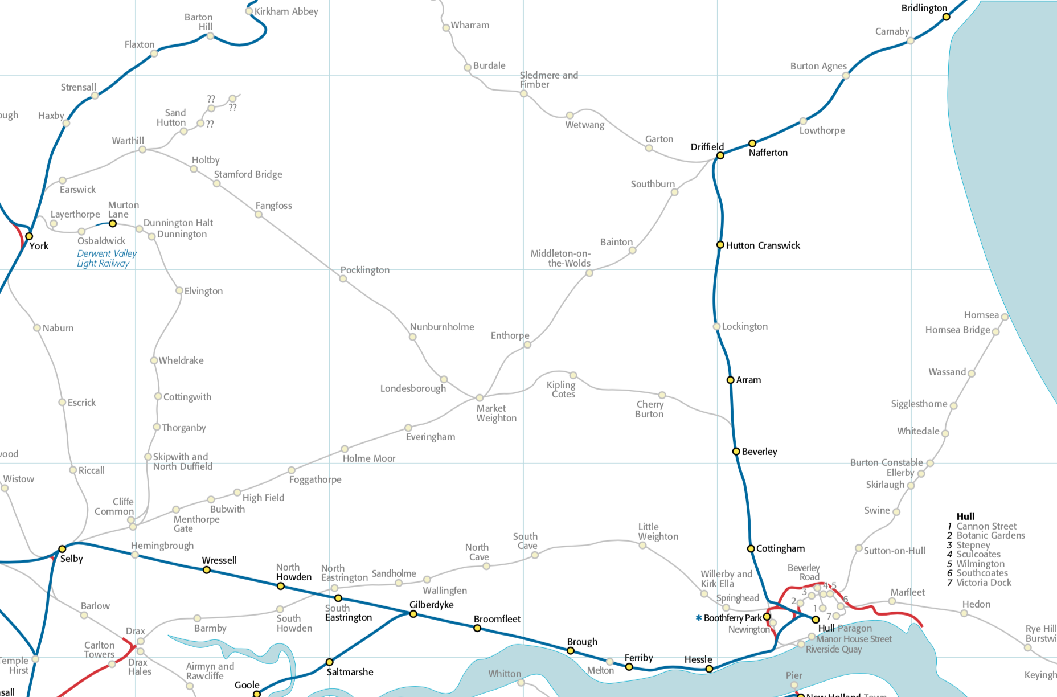

Slide 4
42 miles Hull to York, branching at Beverley
Twin towns: twin themes
Connectivity
Resilience
Hull and Beverley linked with Market Weighton, Pocklington, Stamford Bridge and York by the A1079.
Reinstatement of line will contribute to economic and social future of East Riding, improving public transport, reducing car dependency and encouraging sustainable development.

Slide 5
Alternative link from Hull/ER to national network.
Required because existing rail infrastructure serving Hull lacks resilience.
Improved rail link between East and North Yorkshire = better connectivity.
Therefore not a light rail scheme

Slide 7
2005 Carl Bro report
Commissioned by ERYC: found reinstatement feasible.
Proposed routes round Market Weighton, Pocklington and Stamford Bridge.
Reinstatement = value for money according to DfT’s benefit/cost analysis.
2016 Steer Davies Gleave report
Commissioned by the DfT following meeting with rail minister, Paul Maynard.

Slide 8
Hull-York sub-corridor: poor connectivity, poor reliability
A1079 between Beverley and York: barely adequate for current needs.
ERYC Local Plan Strategy (2016) recognises serious congestion at peak times: “road network cannot be expected to accommodate unconstrained traffic growth”.
Seventh most dangerous road in the UK.
Except for 1.5 miles, 27 miles from Beverley to A64 York bypass are single carriageway.
Growing inadequacy of A1079 affects commuting, freight, tourism and hinders economic growth.
Slow bus services between Hull and York
Market Weighton–Hull: 60 mins (22 miles); Market Weighton–York: 45 mins (21 miles).
At peak times buses caught in heavy congestion and unable to keep to schedule.
Rail services between Hull and York via Selby
Current rail service between Hull and York takes an indirect route via Selby
It is slow: most trains take 62-75 minutes.
Minsters line route would offer a Hull to York journey time of 56 minutes.

Slide 9
Existing routes from Hull to the mainline rail network lack resilience
Main line to Hull from west at risk of disruption: passes along Humber foreshore: high risk of flooding; line closed by flood/tide twice in last ten years.
Predicted sea level rise in Humber estuary will increase frequency.
2010 ERYC draft Climate Change Strategy states that before 2050 “Alternative routes may need to be found or existing routes protected for road and rail infrastructure”.
Swing bridges at Selby and Goole add vulnerability to routes serving Hull
Problems infrequent, but disruption unpredictable and may be long-lasting.
For network resilience a diversionary rail link to Hull is therefore needed.
Line will not replace the main route to the west, but ensure that, if it is disrupted, Hull and East Riding will not be cut off from mainline rail network.

Slide 10
Better connectivity with North Yorkshire
Line will improve rail connectivity with North Yorkshire, allowing journeys from the East Riding via York to Harrogate, Northallerton etc.
The line would play a major role in rail connectivity if main line from Hull is disrupted.
Onward rail travel via York; HS2
Currently long distance rail travellers must go to York by bus or car.
Rail journeys from many parts of East Riding to Scotland via York are impeded by either slow public transport or inadequate roads for journey to York.
Line will connect at York with services to many long-distance destinations.
Plans for HS2 have been welcomed by Yorkshire councils and LEPs.
York will become a major point of connection into HS2.
Without a direct rail link to York, communities and businesses will not be able to make best use of the economic and travel benefits of HS2.

Slide 11
Resilience of main east-west road route serving Hull
Main east-west road artery serving Hull suffers from poor resilience and reliability, with accidents blocking one or both carriageways of the A63 and causing lengthy delays.
Sustainable travel options and economic growth
Sustainable transport objectives
A1079 is seriously congested at peak times.
Without a sustainable public transport alternative, extra journeys resulting from projected housing developments & freight haulage, will have a detrimental effect on journey times, environment, and quality of life.

Slide 12
Changes since 2005 feasibility study
2005: many private car users would switch to a rail service if it were available
A1079 has deteriorated considerably: response would be higher.
Planned journey times are attractive (Hull-York, 36 miles: 56 minutes; Beverley-York, 32 miles: 46 minutes).
Experience of other reopened rail lines = passenger numbers far exceed expectations.

Slide 13
East Riding disadvantaged by unreliable transport infrastructure
ERYC Economic Development Strategy 2012-2016 (2012) advises priority for projects “which deliver connectivity infrastructure for growth”
Delays and unreliability in the area’s transport infrastructure weaken the East Riding’s strategic position with its surrounding cities and also [have] a direct economic cost in terms of reducing productivity through increased journey times.
Reinstatement of line will benefit area by providing an additional route to west, reducing the economic cost of local unreliable transport infrastructure.
Economic growth arising from rail reopenings
There is clear evidence of the economic growth arising from rail reopening.
Following reopening of Borders line, tourism, property prices and inward investment increased considerably.

Slide 14
Travel to work
ERYC Economic Development Strategy 2012-2016 (2012):
45% of East Riding residents travel outside the area for work
20% of the East Riding workforce travel into the area.
Will increase due to housing development = further peak-hour delays.
Education
Many students study at universities and colleges near to home.
Local students at universities/colleges in Hull and York = travel market whose public transport needs are not currently met.
Health
Hospitals in Cottingham and Hull are major centres for medical specialities.
A York-Hull rail service via Beverley, with connecting bus services, will meet the needs of patients and relatives.
It might be possible to build a station by York Hospital.

Slide 15
Retail
Reliable rail service would enable residents to access major retail centres of Hull and York by public transport = reduction in car use.
Tourism
ERYC Economic Development Strategy 2012-16: “underdeveloped tourism offer”.
The towns need visitors to boost economy. Congestion/lack of parking limit potential.
Reinstatement of line could contribute to an increase in tourism.
Hull - new industrial development; freight
As number of passenger trains on main line out of Hull increases = fewer freight paths.
Recent investment in manufacturing by Siemens etc adds pressure on existing routes.
If Hull-York services use the Minsters route, this will free up paths on the main line.

Slide 16
Conclusion: taking it forward
Line will provide improved transport and generate economic growth in East Yorkshire.
But also wider significance, contributing to better rail connectivity and resilience of rail network serving Yorkshire and Humber.
Potential for further development: a York-Bridlington service is possible if a chord is built north of Beverley between the line from York and existing Hull-Scarborough line.
DfT’s policy paper Connecting people: a strategic vision for rail (2017) encourages reopenings.
Asks local authorities and Local Enterprise Partnerships to submit proposals.
Does not meet circumstances of Minsters line, which traverses several local authorities and two LEP areas and has strategic importance beyond the purely local.
Need to evaluate individual potential rail reopenings in a wider strategic context – something beyond the remit of individual local authorities or LEPs

Slide 17
No rail campaign is a solo campaign: therefore we need:
umbrella organisations (e.g. ERTA), networking, collaboration, sharing expertise, information, best practice.
Check us out:
Website: minstersrail.com
Twitter: @MinstersRailNew
Facebook: Minsters Rail Campaign

